Slide 1
Unit 7 Illumination models and surface Rendering

Slide 2
For realistic displaying of 3D scene it is necessary to calculate appropriate color or intensity for that scene.
• Illumination model or a lighting model is the model for calculating light intensity at a single surface point. Sometimes also referred to as a shading model.
• An illumination model is also called lighting model and some times called as a shading model which is used to calculate the intensity of light that we should see at a given point on the surface of a object.
• A surface-rendering algorithm uses the intensity calculations from an illumination model.

Slide 3
Components of Illumination model
• Light Sources: type , color, and direction of the light source
• Surface Properties : reflectance, opaque/transparent, shiny/dull.

Slide 4
An illumination model in computer graphics
• also called a lighting model or a shading model
• used to calculate the color of an illuminated position on the surface of an object
• Approximations of the physical laws
• A surface-rendering method determine the pixel colors for all projected positions in a scene.

Slide 5
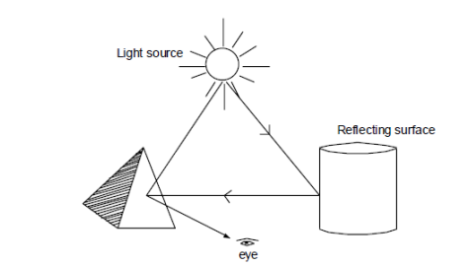
Light Source
Object that radiates energy are called light sources, such as sun, lamp, bulb, fluorescent tube etc.
• Sometimes light sources are referred as light emitting object and light reflectors. Generally light source is used to mean an object that is emitting radiant energy e.g. Sun.
• Total Reflected Light = Contribution from light sources + contribution from reflecting surfaces

Slide 6
Point Source: Point source is the simplest light emitter e.g. light bulb. when light source model is a reasonable approximation for sources whose dimensions are small compared to the size of objects in a scene.
Distributed Light Source: area of source is not small compared to the surfaces in the scene e.g. Fluorescent lamp

Slide 7
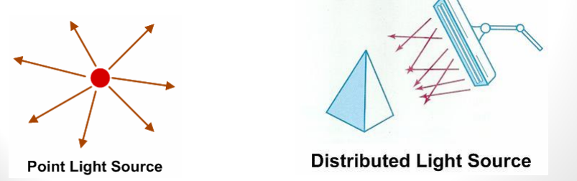

Slide 8
Reflection of light:
When light is incident on opaque surface part of it is reflected and part of it is absorbed. ∴ I = A+R
• The amount of incident light reflected by a surface depends on the type of material. Shining material reflects more incident light and dull surface absorbs more of the incident light.
For transparent surfaces, some of the incident light will be reflected and some will be transmitted through the material.

Slide 9
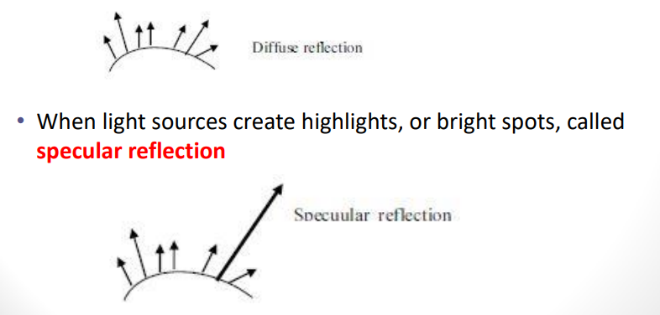
Distributed Light Source
• When light is incident on an opaque surface part of it is reflected and part of it is absorbed. • Surface that are rough or grainy, tend to scatter the reflected light in all direction which is called diffuse reflection.

Slide 10
Illumination models are used to calculate light intensities that we should see at a given point on the surface of an object.
Lighting calculations are based on the optical properties of surfaces, the background lighting conditions and the light source specifications.
All light sources are considered to be point sources, specified with a co-ordinate position and an intensity value (color). Some illumination models are:
Ambient Light
2. Diffuse Reflection
3. Specular Reflection and phong model

Slide 11
1. Ambient Light Source
• This is a simplest illumination model
• We can think of this model, which has no external light source-self-luminous objects. A surface that is not exposed directly to light source still will be visible if nearby objects are illuminated.
• The combination of light reflections form various surfaces to produce a uniform illumination is called ambient light or background light.
• Also called background light
• Ambient light means the light that is already present in a scene, before any additional lighting is added.
It usually refers to natural light, either outdoors or coming through windows etc. It can also mean artificial lights such as normal room lights.

Slide 12
Multiple reflection of nearby (light-reflecting) objects yields a uniform illumination
• Ambient light has no spatial or directional characteristics and amount on each object is a constant for all surfaces and all directions.
In this model, illumination can be expressed by an illumination equation in variables associated with the point on the object being shaded.
The equation expressing this simple model is I=Ka Where I is the resulting intensity and Ka is the object’s intrinsic intensity.

Slide 13
If we assume that ambient light impinges equally on all surface from all direction, then I = Ia Ka Where Ia is intensity of ambient light. Ka is object’s intrinsic intensity.
The amount of light reflected from an object's surface is determined by Ka , the ambient-reflection coefficient.Ka ranges from 0 to 1.

Slide 14
2. Diffuse Reflection
•Incident light is scattered with equal intensity in all directions
•Surfaces appear equally bright from all direction.
•Such surfaces are called ideal diffuse reflectors (also referred to as Lambertian reflectors)
Illuminating object by a point light source, whose rays enumerate uniformly in all directions from a single point.

Slide 15
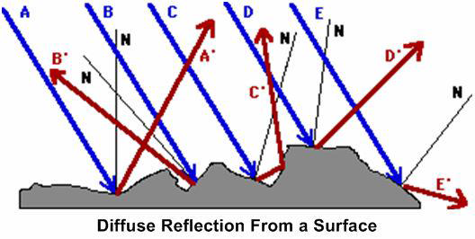

Slide 16
•The object's brightness varies form one part to another, depending on the direction of and distance to the light source.
•Color of an object is determined by the color of the diffuse reflection of the incident light.
•If any object surface is red then there is a diffuse reflection for red component of light and all other components are absorbed by the surface.
Iamb,Diff = kd . Ia, (where Ia = intensity of ambient light)

Slide 17
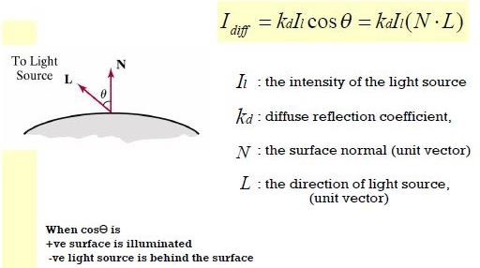
If N is the unit normal vector to a surface and L is the unit direction vector to the point light source from a position on the surface then cos θ = N.L ( Lambertian Cosine Law) and the diffuse reflection equation for single point source illumination is:
IL, diff = kd . IL cos θ = kd IL (N.L)

Slide 18
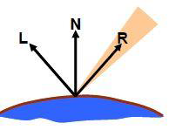
3. Specular reflection and phong model
•When we look at an illuminated shiny surface, such as polished metal, a person's forehead, we see a highlight or bright spot, at certain viewing direction. Such phenomenon is called specular reflection.
•It is the result of total or near total reflection of the incident light in a concentrated region around the " specular reflection angle = angle of incidence".
•Perfect reflector (mirror) reflects all lights to the direction where angle of reflection is identical to the angle of incidence
•It accounts for the highlight

Slide 19
(Surface Shading Method) :
•Illumination model is applied to fill the interior of polygons
•Curved surfaces are approximated with polygon meshes
•Two ways of polygon surface rendering:
1. Single intensity for all points in a polygon
2. Interpolation of intensities for each point in a polygon
•Methods:
1. Constant Intensity Shading
2. Gouraud Shading
3. Phong Shading

Slide 20
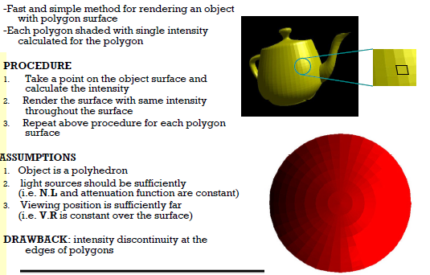
1. Constant Intensity Shading Method(Flat Shading)

Slide 21
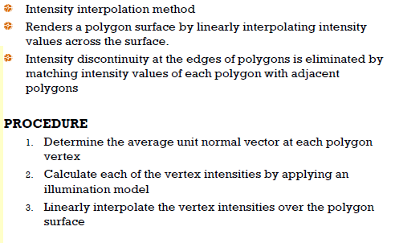
2. Gouraud Shading Method

Slide 22
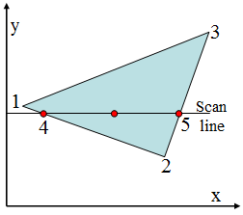
For Gouraud shading, the intensity at point 4 is linearly interpolated from the intensities at vertices 1 and 2.
• The intensity at point 5 is linearly interpolated from intensities at vertices 2 and 3.
• An interior point p is then assigned an intensity value that is linearly interpolated from intensities at positions 4 and 5.

Slide 23

Advantages:
Removes discontinuities of intensity at the edge compared to constant shading model
Limitations:
Highlights on the surface are sometimes displayed with anomalous(irregular) shapes and linear intensity interpolation can cause bright or dark intensity streaks, called Mach Bands to appear on the surfaces. Mach bands can be reduced by dividing the surface into a greater number of polygon faces or Phong shading (requires more calculation).

Slide 24
3.Phong Shading
• A more accurate method for rendering a polygon surface is Phong shading, or normal vector interpolation shading which first interpolate normal vectors, and then apply the illumination model to each surface point. It displays more realistic highlights on a surface and greatly reduces the Mach-band effect.
• A polygon surface is rendered using Phong shading by carrying out the following steps:
Determine the average unit normal vector at each polygon vertex.
Linearly interpolate the vertex normal over the surface of the polygon.
Apply an illumination model along each scan line to calculate projected pixel intensities for the surface points.

Slide 25
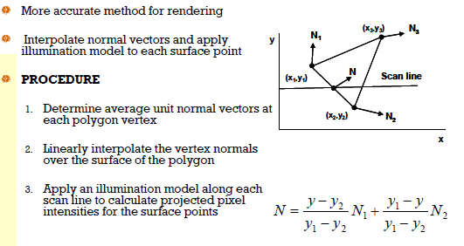

Slide 26
Gouraud Vs Phong Shading
• Gouraud shading is faster than Phong shading
• Phong shading is more accurate

Slide 27
4. Fast Phong Shading:
It approximates the intensity calculations using Taylor’s expansion .
Since Phong Shading interpolates normal vectors from vertex normal, we can express surface normal N at any point (x,y) over triangle as,
N= Ax+By+C
Where A,B and C are determined from three vertex equations Nk= Axk+Byk+C, k=1,2,3 for (Xk,Yk) vertex.
Omitting the reflectivity and attenuation parameters,
Idiff(x,y) = L.N/ (ILI. INI )

